Slide 1
CS3733 Wong
Ch. 2: UML Use Cases

Slide 2
System Development Models
Requirements: Functional Model
User’s point of view of what the system can do for the user
User stories
UML: Use Cases
Design: Object Model
Structure of the system representing objects’ attributes, operations, and associations
System design and object design
UML: Class Diagram
Design: Dynamic Model
Internal behavior of the system
UML: sequence, interaction, activity, statechart diagrams

Slide 3
Modeling
Performed in both SDLC and Agile methodologies
SDLC
Models are thorough and detailed
Agile
Models are created quickly, brief, and replaced in future iterations if necessary
In either case, knowledge of modeling is important!

Slide 4
What is UML?
Unified Modeling Language
Nonproprietary standard for modeling software systems
Convergence of notations used in object-oriented methods
OMT (James Rumbaugh and collegues)
Booch (Grady Booch)
OOSE (Ivar Jacobson)

Slide 5
UML: First Pass
You can model 80% of most problems by using about 20% UML
This class teaches you those 20%
Use case diagrams
Describe the functional behavior of the system as seen by the user
Class diagrams
Describe the static structure of the system: Objects, attributes, associations
Dynamic diagrams
Describes the behavior of objects in the system

Slide 6
UML Core Conventions
All UML Diagrams denote graphs of nodes and edges
Nodes are entities and drawn as rectangles or ovals
Rectangles denote classes or instances
Ovals denote functions
Names of Classes are not underlined
SimpleWatch
Firefighter
Names of Instances are underlined
myWatch:SimpleWatch
Joe:Firefighter
An edge between two nodes denotes a relationship between the corresponding entities

Slide 7
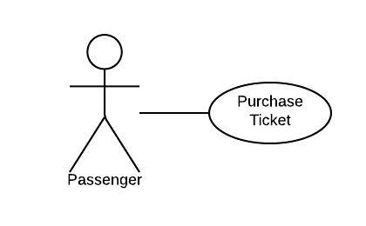
Use Case Diagrams
Used during requirements elicitation and analysis to represent external behavior (“visible from the outside of the system”)
An Actor represents a role – a type of system user
A use case represents a class of functionality provided by the system
Use case model
The set of all use cases that completely describe the functionality of the system.

Slide 8
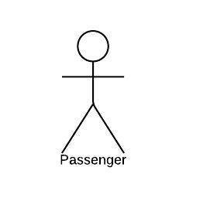
Actors
An actor is a model for an external entity which interacts (communicates) with the system:
User
External system (Another system)
Physical environment (e.g. Weather)
An actor has a unique name and an optional description
Examples:
Passenger: A person in the train
GPS satellite: An external system that provides the system with GPS coordinates.
Optional
Description
Name

Slide 9
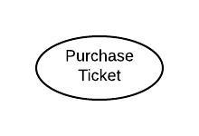
Use Case
• A use case represents a class of functionality provided by the system
• Use cases can be described textually, with a focus on the event flow between actor and system
• The textual use case description consists of 6 parts:
Unique name
Participating actors
Entry conditions
Exit conditions
Flow of events
Special requirements.

Slide 10
Use Case: Textual Description
1. Name: Purchase ticket
2. Participating actor: Passenger
3. Entry condition:
Passenger stands in front of ticket distributor
Passenger has sufficient money to purchase ticket
4. Exit condition:
Passenger has ticket
5. Flow of events:
1. Passenger selects the number of zones to be traveled
2. Ticket Distributor displays the amount due
3. Passenger inserts money, at least the amount due
4. Ticket Distributor returns change
5. Ticket Distributor issues ticket
Alternate Flow of Events:
None
6. Special requirements: None
Notes:
Question: Anything missing? Answer: Exceptional cases!
Use cases represent functionality of the system
All use cases need to be described for the model to be useful
Use case diagrams are useful as an index into the use cases
The Textual Use case descriptions provide meat of model, not the use case diagrams.

Slide 11
Uses Cases can be related
Extends Relationship
To represent seldom invoked use cases or exceptional functionality such as canceling an operation
Includes Relationship
To represent functional behavior common to more than one use case
Inheritance Relationship
To represent generalization

Slide 12
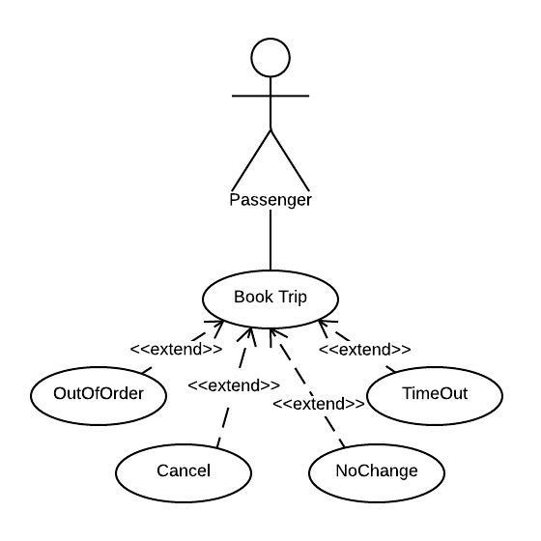
Extend Use Case
<<extend>> relationships model unexpected conditions, errors, or help
The exceptional event flows are factored out of the main event flow for clarity
The direction of an <<extend>> relationship is to the extended use case
Use cases representing exceptional flows can extend more than one use case.

Slide 13
Extend Textual Description
1. Name: Purchase ticket
2. to 4. (same as original example)
5. Flow of events:
1. Passenger selects the number of zones to be traveled
2. Ticket Distributor displays the amount due
3. Passenger inserts money, at least the amount due
4. Ticket Distributor returns change
5. Ticket Distributor issues ticket
Alternate flow of events:
[Cancel]
Passenger presses Cancel button
Ticket Distributor returns money passenger has inserted, if any
Cancel Extend Use Case
Note: Your textbook gives an extend use case its own full textual description rather than being just an alternate flow. The more common practice today is the version I have specified above. Use the version listed on this slide.
Notes:
Question: Anything missing? Answer: Exceptional cases!
Use cases represent functionality of the system
All use cases need to be described for the model to be useful
Use case diagrams are useful as an index into the use cases
The Textual Use case descriptions provide meat of model, not the use case diagrams.

Slide 14
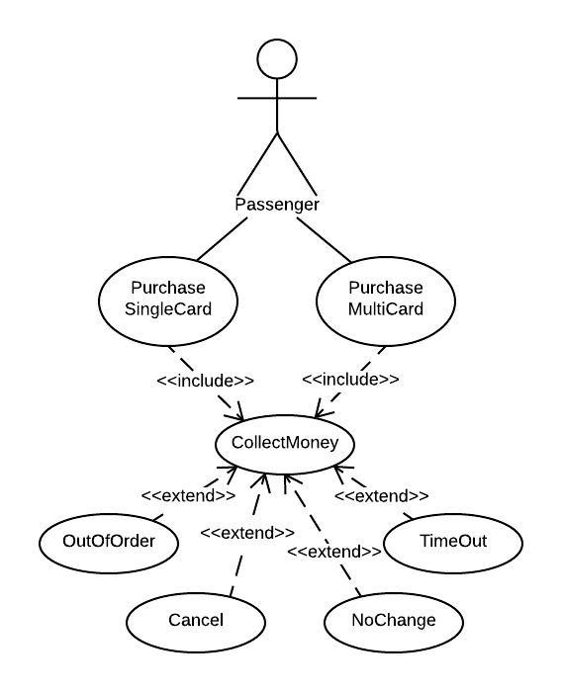
Include Relationship
<<include>> relationship represents common functionality needed in more than one use case
<<include>> behavior is factored out for reuse, not because it is an exception
The direction of a <<include>> relationship is to the using use case (unlike the direction of the <<extend>> relationship).

Slide 15
Include Textual Description
1. Name: Book Flight
2. to 4. (same as original example)
5. Flow of events:
1. Passenger selects the number of zones to be traveled
2. Ticket Distributor displays the amount due
3. Passenger inserts money, at least the amount due, include (Collect Money)
4. Ticket Distributor returns change
5. Ticket Distributor issues ticket
Alternate flow of events:
[Cancel]
Passenger presses Cancel button
Ticket Distributor returns money passenger has inserted, if any
Include Use Case
This refers to a separate textual description use case describing the collection of money
Notes:
Question: Anything missing? Answer: Exceptional cases!
Use cases represent functionality of the system
All use cases need to be described for the model to be useful
Use case diagrams are useful as an index into the use cases
The Textual Use case descriptions provide meat of model, not the use case diagrams.

Slide 16
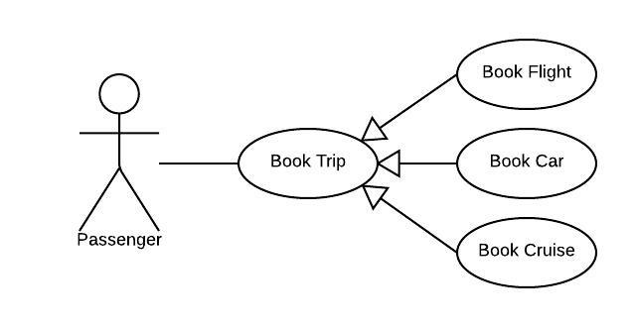
Inherit Relationship
Inherit relationship represents a generalization of other use cases
Child use cases inherit behavior from the parent use case.
Child use cases can add to or override parent behavior.
Note the direction of the arrows!

Slide 17
Inheritance Textual Description
1. Name: Book Trip
2. Actors: Passenger
3. Entry condition:
At point of date selection
4. Exit condition:
Trip has been booked
5. Flow of events:
Select location
Select start date
Select end date
Alternate Flow of Events:
None
6. Special requirements: None
1. Name: Book Car
2. Actors: Inherited from Book Trip
3. Entry condition:
Inherited from Book Trip
4. Exit condition:
Inherited from Book Trip
5. Flow of events:
– 3. Inherited from Book Trip
4. Select make of car
5. Select model of car
Alternate Flow of Events:
None
6. Special requirements: None
Notes:
Question: Anything missing? Answer: Exceptional cases!
Use cases represent functionality of the system
All use cases need to be described for the model to be useful
Use case diagrams are useful as an index into the use cases
The Textual Use case descriptions provide meat of model, not the use case diagrams.

Slide 18
Functional Model Relationships
A scenario is an instance of a use case
Use proper nouns and detail specific actions
Conversely, a use case is a generalized version of a scenario
A single use case typically consists of multiple user stories
Many actors may be in a use case whereas only one user role is in a user story
Actors may perform multiple functionalities whereas a user role only performs a single one
Notes:
Next goal after all the scenarios are formulated is to find all the uses cases in the scnario

Slide 19
Finding Use Cases
Formulate scenarios
Generalize a scenario into a use case that specifies all instances of how the feature works
Example: “Report Emergency“ in the first paragraph of the scenario from the Chapter 4 slides is a candidate for a use case
Describe each of these use cases in more detail
Participating actors
Describe the entry condition
Describe the flow of events
Describe the exit condition
Describe exceptions
Describe nonfunctional requirements
Notes:
Next goal after all the scenarios are formulated is to find all the uses cases in the scnario

Slide 20
Use Case Guidelines
Typically most use cases are directly related to the actors
Do NOT create use cases to take the place of flowcharts. This is NOT what includes use cases are for!
Entry conditions eliminate the need to link use cases like flow charts
Extend use cases are common. Includes use cases less common. Inheritance use cases are often confusing and should be applied sparingly, if at all.

Slide 21
User Stories vs. Use Cases
Reminder
User Story | Use Case
Provide a small-scale and easy-to-use presentation of information | A generalized description of a set of interactions between the system and one or more actors, where an actor is either a user or another system
Are generally formulated in the everyday language of the user and contain little detail, thus remaining open to interpretation | Describe a process and its steps in detail, and may be worded in terms of a formal model
They should help the reader understand what the software should accomplish | A use case is intended to provide sufficient detail for it to be understood on its own

Slide 22
Exercise
You have been assigned the task of implementing a feature for the Freedom Trail mobile app to locate nearby places of a certain type – restaurants, public transportation, museums, etc. A user has to login in to the app before, he or she can run the program.
Use LucidChart to create a use case diagram
Write the textual use cases
Compare your textual use cases to your user story conversations

